Slide 1
Research presentation February 2021 Nadia Oliveri 5514878
’’The awareness and adherence of pregnancy prevention while using products containing valproate’’
Supervisor: Ramune Jacobsen Examiner: Marcel Bouvy
Notes:
Welcome everyone, I am Nadia Oliveri and in this presentation I will guide you through my research project which I performed at the University of Copenhagen at the depertment of Social and Clinical Pharmacy this last semester. The presentation will be about the awareness and adherence of pregnancy prevention while using products containing valproate.

Slide 2

Introduction
Valproic acid
Teratogenic effects
EMA recommendations for the use of valproate in 2014
Updated recommendations in 2018: ‘Pregnancy prevention program’
Notes:
The drug my resarch is foccused on is valproate, this is a drug mainly used for the treatment of epilepsy and bipolar disorder. Unfortunately terotogenic effects have been associated with the use of valproate.
Due to these severe side effects a division of European Medicine Agency provided recommendations in 2014 and 2018 to strengthening the restrictions on the use of valproate. The precautions from 2014 did not have the desired effect. As a result, the EMA generated new recommendations for the use of valproate in 2018.
A pregnancy prevention program was developed. This program is designed to ensure the knowledge of patients and health care professionals about the risks of valproate during pregnancy and to provide a good environment for consultation about pregnancy and valproate.

Slide 3
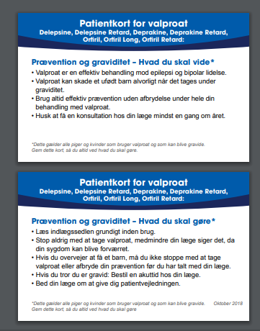
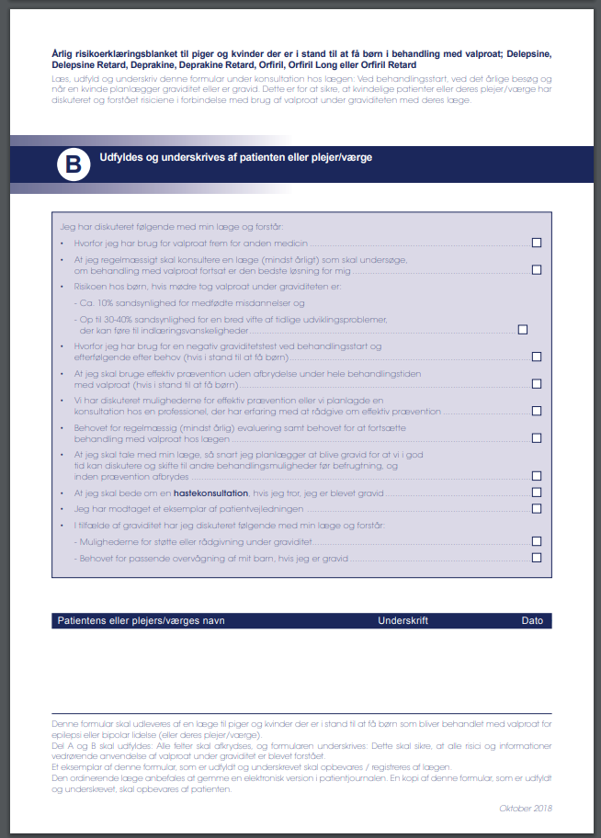
Notes:
Examples of the content of the pregnancy prevention program are shown is this slide.
Left: you can find an example of a patient reminder card which a health care professional needs to provide to a patient when prescribing or dispensing valproate. The card contains information about the risks during pregnancy and the need to use contraception.
Right: this is a risk acknowledgments checklist, which needs to be signed by the patient when valproate is prescribed.

Slide 4
Aim of the study
Awareness about teratogenic effects and the recommendations
Adherence to the recommendations
Impact of the recommendations
Notes:
A European broad study is generated by the EMA to determine the influence of the pregnancy prevention program in 8 different countries included Denmark. My research is foccused on the infucence of this program in Denmark, but a comparison with the EU results will be made.
My resarch investigated:
The awaraness of HCPs and patients about the teratogenic effects of valproate and the recommendations provided in 2018
The adherence of HCPs and patients to these reccommendations
The impact of the recomendations on prescribing, dispensing and the use of valproate

Slide 5
Method
Web-based questionnaires lime surveys among:
HCPs: medical specialists, GP’s and pharmacists
Patients: females 15-50 years old, not pregnant and have used valproate related substances (<5 years)
Descriptive statistics
Bivariate analysis:
HCPs: effect of years of experience, profession and gender
Patients: effect of level of education and age
Notes:
Web-based questionnaires were sent to HCPs and patients. HCP stands for HCP in the following slides. The questionnaires contained multiple choice questions and open-ended questions. The open ended questions were used for the discussion part and the multiple choice provided descriptive statistics.
Besides that, bivariate analysis was performed to investigate which determinants play an important role in the distribution of the adherence, awareness and impact.
For the HCPs the effect of years of experience, profession and gender on the outcomes were analyzed.
For the patients, level of education and age are analyzed.

Slide 6
Results – demographics
Prescribers
90 included
Mean age (SD) = 51 years old (10)
62% female
GP’s: 16%
Neurologists: 62%
Pharmacists
98 included
Mean age (SD) = 39 years old (12)
76% female
Hospital pharmacist: 11%
Community pharmacist: 89%
Patients
103 included
Mean age = 38 years old
42% finished university

Slide 7
Results – awareness HCP
When did you learn about the teratogenic risks of valproate?
Prescribers
Only one through the questionnaire
73% more than 5 years ago
Pharmacists
15% through the questionnaire
51% in the past 5 years
EU study average 6% unawareness
Notes:
Results regarding the awarness about teratogenic effects were high. Only one prescriber obtained the knowledge just through the questionnaire and a majority (73%) had heard it more than 5 years ago.
For pharmacists the awarness was lower, with 15% obtaining the knowledge through the questionnaire and 51% had heard it in the past 5 years.

Slide 8
Results – awareness Patients
Knowledge about teratogenic effects of valproate
82% were aware of which 63% through a neurologist
Decline in awareness once the level of education decreased
Carefulness regarding birth control during valproate use
28% agree
40% disagree
EU study average of agreeing: 52%
Age 15-20 years no agreed to be careful
Notes:
For the patient’s awareness, 82% were aware of the teratogenic effects of which 63% by a neurologist. The bivariate analysis showed a decline in awareness once the level of education decreased.
To the statement if patients were careful with the use birth control during the use of valproate only 11% agreed. Compared to the EU broad study this percentage is low, the EU average is 52%. No one in the youngest age group agreed to be careful with birth control during the use of valproate.

Slide 9
Results – adherence HCP
Prescribers
Pharmacists
HCP guide and patient guide more applied by specialists than GPs
Low use of warning sign compared to EU study average (50%)
Notes:
Regarding the adherence of prescribers with the pregnancy prevention measurements, the patient guide was most applied (28%) following the health care professional guide (23.3%) and the direct to healthcare professional communication (DHPC) (23.3%) (figure 4). The signing of the RAF/checklist was applied the least often (5.6%).
The use of the warning sign in the outer package was the most applied pregnancy prevention measurement for pharmacists with a percentage of 23.5%. Compared to the EU average the use is very low.

Slide 10
Results – adherence patients
Notes:
The majority of the patients (75%) had read the patient information leaflet included in the medication package. Signing and reviewing the RAF and the patient card were the least often performed.

Slide 11
Results – impact HCP
Change in prescribing and counselling since the new recommendations:
35% disagreed
27% agreed
HCP guide and DHPC had the most impact
Change in dispensing since the new recommendations:
23% disagreed
24% agreed
Warning sign and DHPC had the most impact
Notes:
The majority of the prescribers (35%) stated that their prescribing and counselling to women of reproductive age did not change, and 27% said that it did change. Of the 24 prescribers who stated that their prescribing changed, the health care professional guide had the most impact (50%), followed by the DHPC (38%)
Most of the pharmacists (28%) are not sure if the the information they provide to women of reproductive age when dispensing valproate had changed since the implementation of the pregnancy prevention measures. The warning sigh and the DHPC had the most impact.

Slide 12
Results – impact patients
Change in use of valproate since 2018:
8% said it changed
41% use it the same way
Notes:
Change in the use of valproate was not often seen. Only 8% of the patients said that it changed and 41% use it in the same was as before.

Slide 13
Discussion
Awareness
Awareness pharmacists low compared to prescribers and EU study average
High awareness among patients of risks, however low carefulness regarding birth control
Adherence
Low use of the risk acknowledgment form, lack of awareness and no need if consent is already given
Warning sign for pharmacists most used, other measurements lack of availability and awareness
Notes:
The included pharmacists are younger than the included prescribers, this could explain that most of the pharmacists obtained the knowledge of the teratogenic risks more recent than the prescribers.
For patients it is remarkable that there is a high awareness but low carefulness regarding the use of birth control.
For the adherence a very low use (prescribers and patients results) of the RAF is found, bases on the open ended questions, this is due to lack of awareness of this measurement and that there is no need to use it if consent to the treatment is already given.
For pharmacist the warning sign is most used, the other measurements lack availability and awareness.
Regarding the method of the study selection bias occurred by recruiting participants via certain associations and Facebook groups. Also only neurological patients were recruited and not bipolar patients who use valproate. Due to the questionnaire recall bias and social desirability occurred. Participants had to remind if they used the measurements or not and the chance exists that they would answer in a social desirability way.

Slide 14
Conclusion & improvements
High awareness of teratogenicity of valproate among HCPs and patients
Low adherence to the new measurements
Low impact of the measurements
Better definition of the role of each HCP in this process
Easier and electronic access of the materials
Campaigns to be held to repeat the information
Notes:
In conclusion, high awareness of teratogenicity of valproate was found for HCPs and patients. But low adherence and impact to the measurements was found. Based on the open-ended questions some improvements were raised: a better definition of the role of each HCP in this process to provide the best pregnancy prevention. Regarding the materials, easier and electronic access could help. And more campaigns should be held to remind people of this program.

Slide 15
Literature
Haddad PM, Das A, Ashfaq M, Wieck A. A review of valproate in psychiatric practice. Expert Opin Drug Metab Toxicol. 2009;5(5):539-51.
Tomson T, Battino D, Perucca E. Teratogenicity of antiepileptic drugs. Curr Opin Neurol. 2019;32(2):246-52.
Tomson T, Battino D, Bonizzoni E, Craig J, Lindhout D, Perucca E, et al. Comparative risk of major congenital malformations with eight different antiepileptic drugs: a prospective cohort study of the EURAP registry. Lancet Neurol. 2018;17(6):530-8.
Bromley R, Weston J, Adab N, Greenhalgh J, Sanniti A, McKay AJ, et al. Treatment for epilepsy in pregnancy: neurodevelopmental outcomes in the child. Cochrane Database Syst Rev. 2014;2014(10):Cd010236.
Christensen J, Grønborg TK, Sørensen MJ, Schendel D, Parner ET, Pedersen LH, et al. Prenatal valproate exposure and risk of autism spectrum disorders and childhood autism. Jama. 2013;309(16):1696-703.
(EMA) EMA. New measures to avoid valproate exposure in pregnancy endorsed 23 March 2018 [Available from: https://www.ema.europa.eu/en/news/new-measures-avoid-valproate-exposure-pregnancy-endorsed

