Slide 1
Impact of EU label changes and pregnancy prevention programmes for medicinal products containing valproate-related substances and oral retinoids: risk awareness and adherence
Anastasia Lili
Department of Pharmacoepidemiology and Clinical Pharmacology
Utrecht Institute for Pharmaceutical Sciences
Utrecht, January 2021

Slide 2
Research Objectives
Methods
Study sample
Results
Conclusion
To assess the awareness of the Pregnancy Prevention Programme and risk of teratogenic effects in women of childbearing potential and pregnant women exposed to valproate/oral retinoid containing medicinal products among patients and healthcare providers
To assess the adherence to the Pregnancy Prevention Programme and risk minimization measures
Educational materials for patients and healthcare providers
Effective contraception
Medically supervised pregnancy testing
Patients’ signature for prescribers’ checklist
Notes:
,

Slide 3
Research Objectives
Methods
Study sample
Results
Conclusion
Setting
Study design
Recruitment strategies
Countries
Belgium
Denmark
Greece
Latvia
Netherlands
Portugal
Slovenia
Spain
Population
Prescribers (GPs & specialists)
Pharmacists
Women in childbearing age
Vary per country
Institutional recruitment
E-mail collection: public registers, telephone contact
Professional organizations/networks
Survey link distribution
Newsletters
Through professional app alerts
QR codes
Social Media
Patient Organizations
Referral from HCPs (pharmacies, practices)
Own network/contacts
Data collection
Electronic surveys > Close &
Open-ended questions
Analysis
Descriptive Statistics

Slide 4
Inclusion criteria of responders for valproate
Research Objectives
Methods
Study sample
Results
Conclusion
Patients
b) Pharmacists
Informed consent and respond to at least the 1st question
n= 428
Informed consent & respond to at least the 1st question
n= 720
Not a woman n= 76
Pregnant/no pregnancy status n= 22
Never used valproate n= 7
Never dispensed valproate n= 157
Included for analysis
n= 323
Included for analysis
n= 563
Age(M): 39
Female: 74%
Community-based: 95%
Age(M): 37
Undergraduate education: 28%
c) Prescribers
Informed consent & respond to at least the 1st question
n= 747
Pharmacists n= 15
Nurses n=1
No information regarding profession n=1
Never prescribed valproate n=166
Included for analysis
n= 564
Age(M): 45
Female: 64%
Specialists: 59%

Slide 5
Inclusion criteria of responders for oral retinoids
Research Objectives
Methods
Study sample
Results
Conclusion
Patients
b) Pharmacists
Informed consent & respond to at least the 1st question
n= 400
Informed consent & respond to at least the 1st question
n= 722
Not a woman n= 51
Pregnant/no pregnancy status n= 7
Never used oral retinoids n=44
Never dispensed oral retinoids n=62
Included for analysis
n= 298
Included for analysis
n= 660
Age(M): 39
Female: 78%
Community-based: 98%
Age(M): 26
Isotretinoin users: 95%
Undergraduate education: 37%
c) Prescribers
Informed consent & respond to at least the 1st question
n= 671
Never prescribed oral retinoids n=111
Included for analysis
n= 560
Age(M): 45
Female: 68%
Dermatologists: 62%

Slide 6
Overview response per country
Research Objectives
Methods
Study sample
Results
Conclusion
Valproate
 | Overall |  | BE | DK | GR | LV | NL | PT | SL | ES
Total responders (n)
Patients | 323 |  | 33 | 103 | 58 | 16 | 5 | 39 | 31 | 38
Pharmacists | 563 |  | 75 | 97 | 66 | 49 | 66 | 68 | 68 | 74
Prescribers | 564 |  | 42 | 89 | 96 | 103 | 15 | 83 | 61 | 75
Oral Retinoids
 | Overall |  | BE | DK | GR | LV | NL | PT | SL | ES
Total responders (n)
Patients | 298 |  | 48 | 51 | 63 | 17 | 21 | 26 | 30 | 42
Pharmacists | 660 |  | 71 | 96 | 62 | 51 | 88 | 133 | 60 | 99
Prescribers | 560 |  | 48 | 63 | 98 | 48 | 114 | 104 | 35 | 50

Slide 7
Ia : Awareness of the risks per group
Research Objectives
Methods
Study Sample
Results
Conclusion
Patients:
Valproate (n=323)
Yes: 71% (n=230)
No: 19% (n=63)
Oral Retinoids (n=298)
Yes: 96% (n=285)
No: 2% (n=7)
Pharmacists:
Valproate(n=563)
Yes: 93% (n=522)
No: 6% (n=33)
Oral Retinoids (n=660)
Yes: 98% (n=648)
No: 1% (n=5)
Prescribers:
Valproate (n=564)
Yes: 94% (n=532)
No: 5% (n=26)
Oral Retinoids (n=560)
Yes: 97% (n=545)
No: 2% (n=11)
Notes:
Point that the results will be mainly presented based on the aggregated data of all countries but there are some slides later on focusing on the results per country. In this study, women who were current and former users of oral retinoids were more aware about their teratogenic risks than women who were using or had used valproate-related products. High awareness about the risks was observed among healthcare professionals for both products.

Slide 8
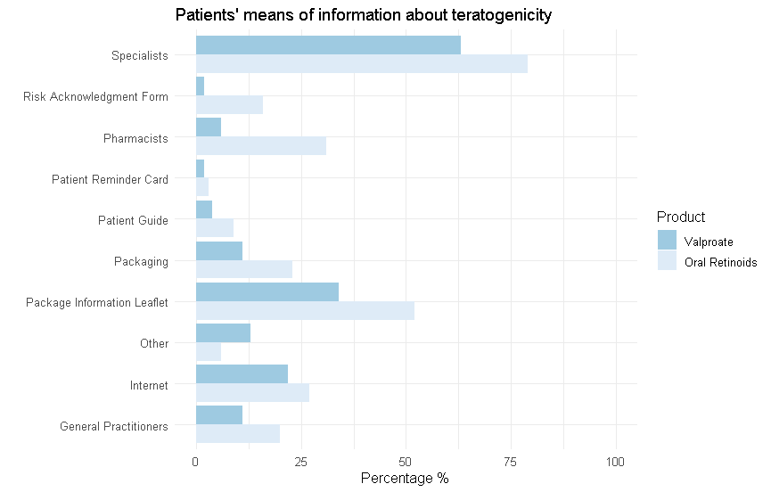
Ib: Source of Information per group
Research Objectives
Methods
Study Sample
Results
Conclusion

Slide 9
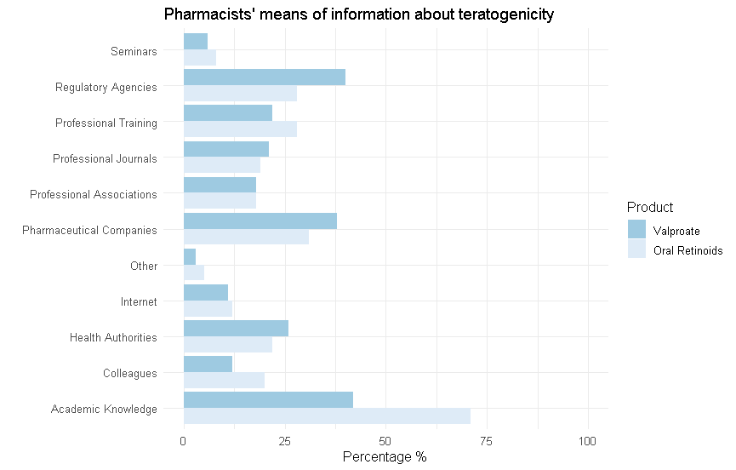
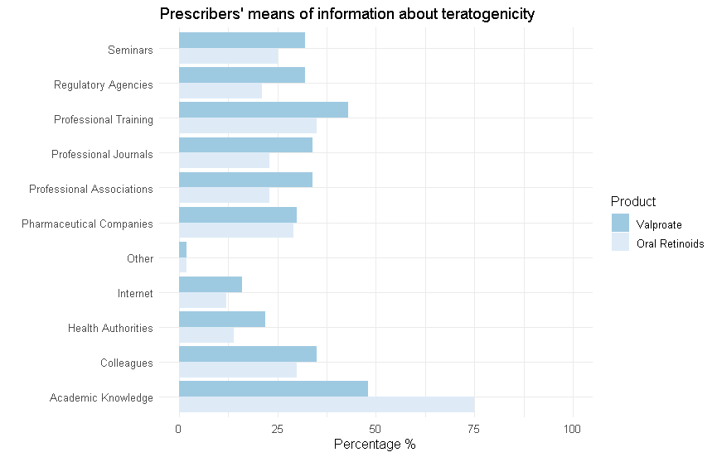
Ic: Source of Information per group
Research Objectives
Methods
Study Sample
Results
Conclusion

Slide 10
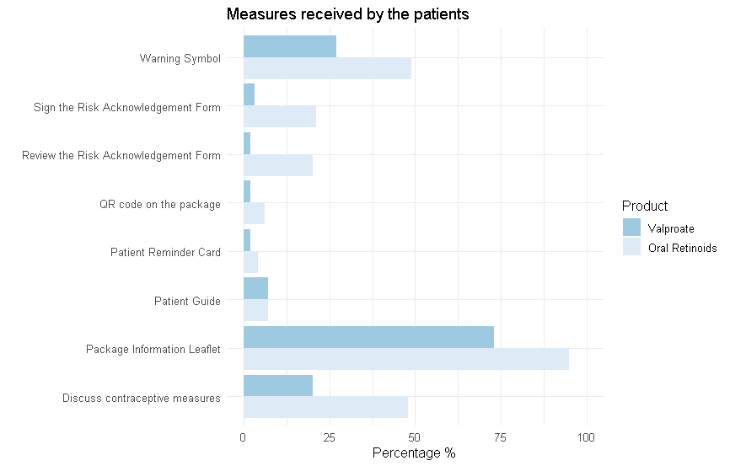
IIa: Recall of measures by patients
Research Objectives
Methods
Study Sample
Results
Conclusion

Slide 11
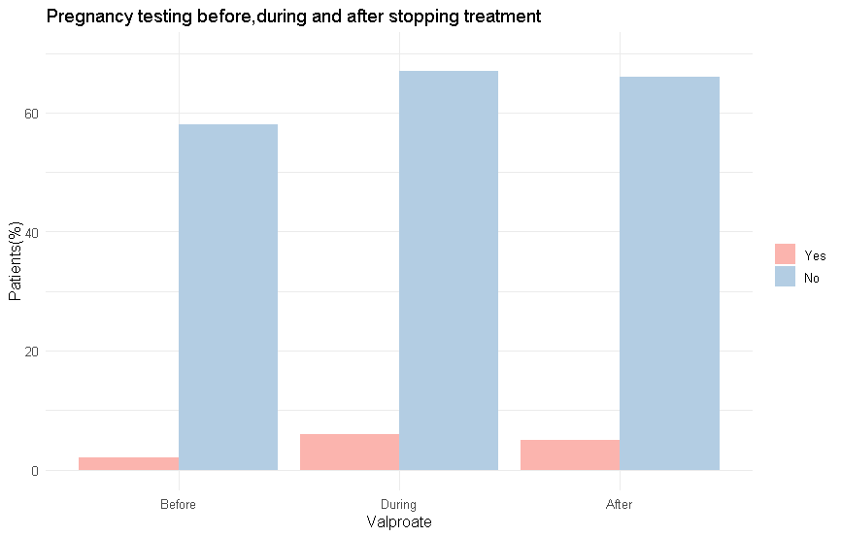
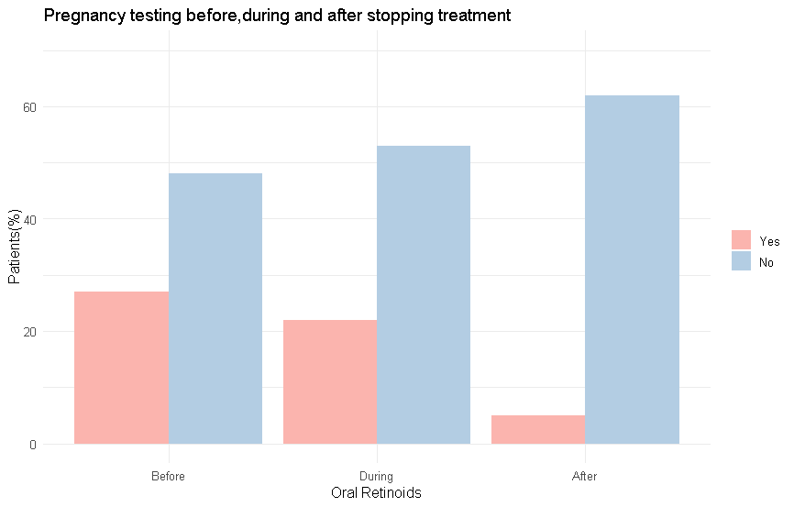
IIb: Performance of pregnancy testing
Research Objectives
Methods
Study Sample
Results
Conclusion
* DK, LV, NL: performance of pregnancy testing before & during treatment by half of patients

Slide 12
IIc: Contraception use
Research Objectives
Methods
Study Sample
Results
Conclusion
Valproate (n=323)
Yes: 40% (n=129)
No: 36% (n=116)
No need for: 11% (n=34)
Oral Retinoids (n=298)
Yes: 53% (n=158)
No: 27% (n=80)
No need for: 11% (n=32)
Careful when use valproate(52%) & oral retinoids (79%)
Notes:
risk of pregnancy still exists because they are still women at childbearing and no contraception or less effective contraception

Slide 13
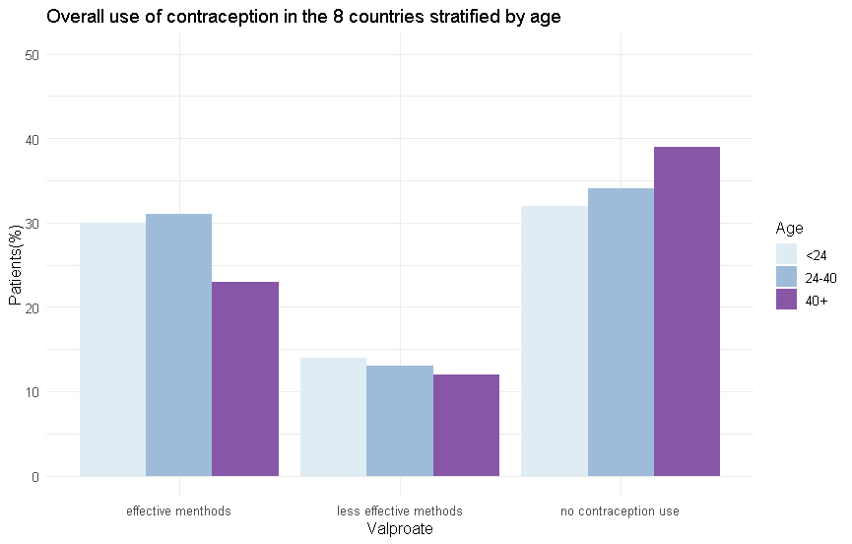
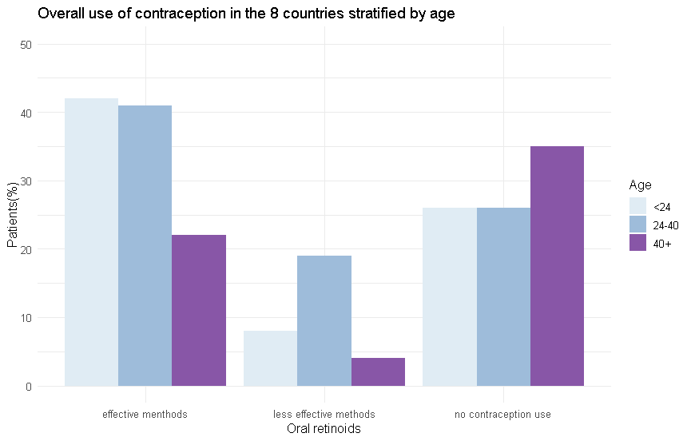
Results IId: Contraception use stratified by age
Notes:
risk of pregnancy still exists because they are still women at childbearing and no contraception or less effective contraception

Slide 14
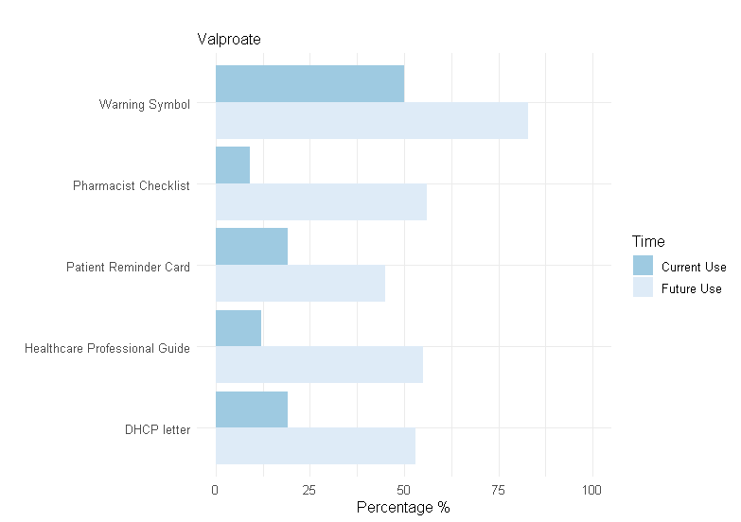
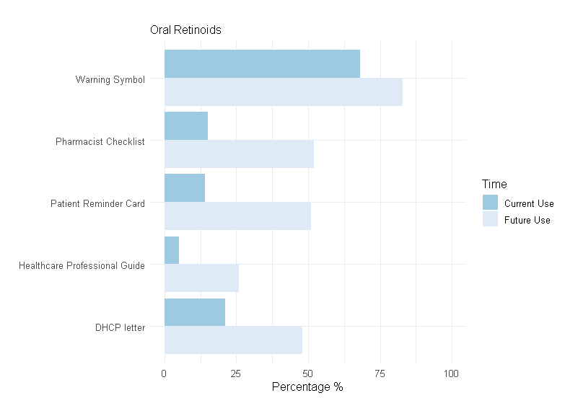
IIIa: Awareness and use of measures by pharmacists
Research Objectives
Methods
Study Sample
Results
Conclusion

Slide 15
IIIb: Awareness and use of measures by pharmacists per country
Study Sample
Results
Research Objectives
Methods
Conclusion
Valproate
 | Overall |  | BE | DK | GR | LV | NL | PT | SL | ES
Total | 563 |  | 75 | 97 | 66 | 49 | 66 | 68 | 68 | 74
Any use of preventive measure
Healthcare professional guide Pharmacist Checklist Warning symbol Patient reminder card DHCP letter missing data | 66(12%) 52(9%) 279(50%) 108(19%) 108(19%) 61(11%) |  | 1(1%) 1(1%) 30(40%) 3(4%) 2(3%) 10(13%) | 4(4%) n/a 23(24%) 5(5%) 13(13%) 17(18%) | 16(24%) n/a 28(42%) 5(8%) 13(20%) 0 | 7(14%) 15(31%) 34(69%) 7(14%) 14(29%) 5(10%) | 12(18%) 18(27%) 37(56%) 8(12%) 5(8%) 7(11%) | n/a n/a 43(63%) 41(60%) 33(48%) 4(6%) | 7(10%) 5(7%) 36(53%) 7(10%) 14(21%) 8(12%) | 19(26%) 13(18%) 48(65%) 32(43%) 14(19%) 10(14%)
Oral retinoids
 | Overall |  | BE | DK | GR | LV | NL | PT | SL | ES
Total | 660 |  | 71 | 96 | 62 | 51 | 88 | 133 | 60 | 99
Any use of preventive measure
Healthcare professional guide Pharmacist Checklist Warning symbol Patient reminder card DHCP letter missing data | 36 (5%) 102(15%) 451(68%) 91 (14%) 137 (21%) 41 (6%) |  | 3(4%) 3(4%) 54(76%) 5(7%) 2(3%) 3(4%) | 8(8%) 5(5%) 43(45%) 1(1%) 11(11%) 9(9%) | n/a n/a 48 (77%) 0 6(10%) 0 | n/a 8(16%) 30(59%) 8(16%) 12(24%) 2(4%) | 25(28%) 40(45%) 81(92%) 23(26%) 6(7%) 2(2%) | n/a 36(27%) 86(65%) 32(24%) 48(36%) 15(11%) | n/a 10(17%) 47(78%) 4(7%) 19(32%) 3(5%) | n/a n/a 62(63%) 18(18%) 34(34%) 7(7%)

Slide 16
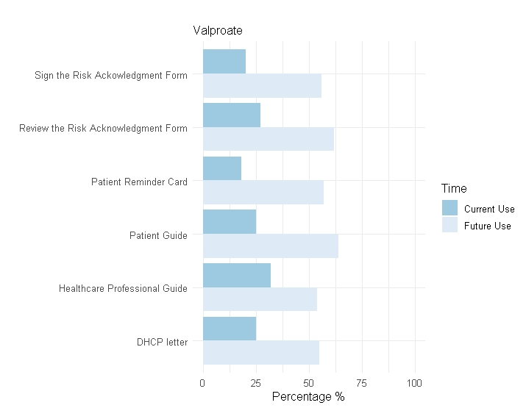
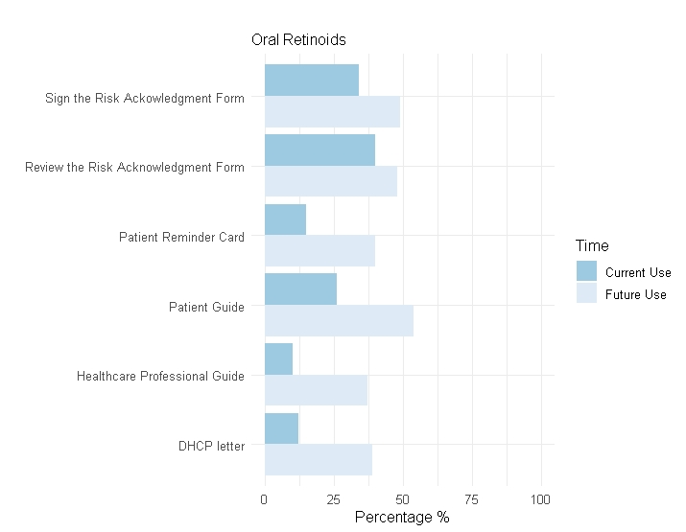
IVa: Awareness and use of measures by prescribers
Research Objectives
Methods
Study Sample
Results
Conclusion

Slide 17
IVb: Awareness and use of measures by prescribers per country
Research Objectives
Methods
Study Sample
Results
Conclusion
Valproate
 | Overall |  | BE | DK | GR | LV | NL | PT | SL | ES
Total | 564 |  | 42 | 89 | 96 | 103 | 15 | 83 | 61 | 75
Any use of preventive measure
Healthcare professional guide Patient guide Review the Risk Acknowledgment form Sign the Risk Acknowledgment form Patient reminder card DHCP letter missing data | 178(32%) 141(25%) 155(27%) 112(20%) 103(18%) 142(25%) 45(8%) |  | 7 (17%) 6(14%) 8(19%) 6(14%) 7(17%) 4(10%) 6(14%) | 21(24%) 25(28%) 12(13%) 5(6%) 12(13%) 21(24%) 9(10%) | 48(50%) 24(25%) 37(39%) 12(12%) 11(11%) 30(31%) 3(3%) | 30(29%) 38(37%) 52(50%) 51(50%) 50(49%) 28(27%) 7(7%) | 7(47%) 2(13%) 2(13%) 2(13%) 2(13%) 1(7%) 0 | 11(13%) 6(7%) 8(10%) 1(1%) n/a 14(17%) 5(6%) | 13(21%) 15(25%) 9(15%) 6(10%) 7(11%) 11(18%) 8(13%) | 41(55%) 25(33%) 27(36%) 29(39%) 14(19%) 33(44%) 5(7%)
Oral retinoids
 | Overall |  | BE | DK | GR | LV | NL | PT | SL | ES
Total | 560 |  | 48 | 63 | 98 | 48 | 114 | 104 | 35 | 50
Any use of preventive measure
Healthcare professional guide Patient guide Review the Risk Acknowledgment form Sign the Risk Acknowledgment form Patient reminder card DHCP letter missing data | 58 (10%) 147 (26%) 224(40%) 189(34%) 86(15%) 68(12%) 50(9%) |  | 7(15%) 19(40%) 14(29%) 9(19%) 3(6%) 2(4%) 6(13%) | 12(19%) 27(43%) 6(10%) 2(3%) 9(14%) 9(14%) 7(11%) | n/a n/a 44(45%) 17(17%) 20(20%) 17(17%) 0 | n/a n/a 31(65%) 29(60%) 10(21%) 7(15%) 6(13%) | 29(25%) 93(82%) 73(64%) 78(68%) 22(19%) 2(2%) 7(6%) | 10(10%) 8(8%) 8(8%) 6(6%) n/a 14(14%) 19(18%) | n/a n/a 21(60%) 22(63%) 13(37%) 7(20%) 1(3%) | n/a n/a 27(54%) 26(52%) 9(18%) 10(20%) 4(8%)

Slide 18
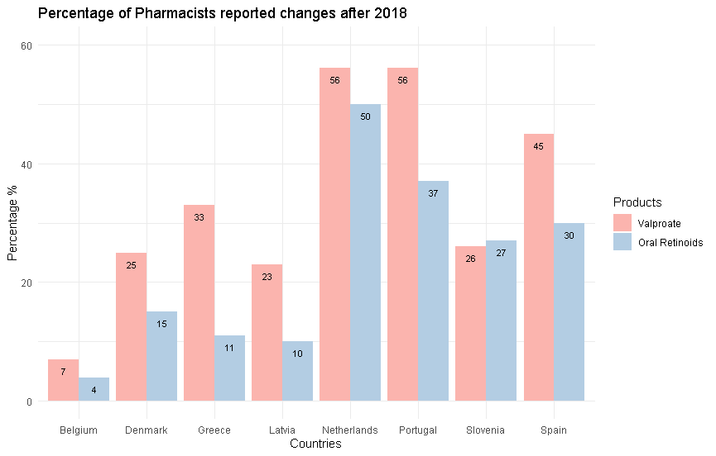
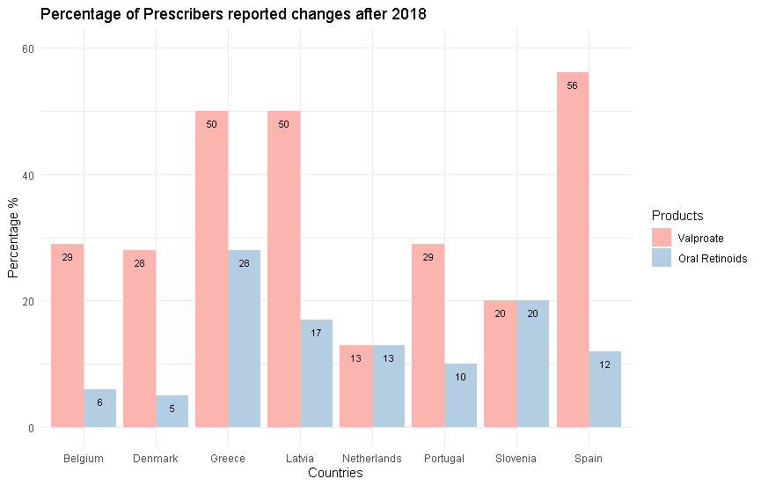
V: Changes to practice after the measures were implemented in 2018
Research Objectives
Methods
Study Sample
Results
Conclusion
33% (valproate)
25% (oral retinoids)
38% (valproate)
14% (oral retinoids)

Slide 19
Research Objectives
Methods
Study Sample
Results
Conclusion
High awareness of teratogenic risks among patients and healthcare professionals
Higher awareness of oral retinoids users than valproate users
Patients: specialists and package information leaflet
HCPs: academic or professional training
Low to moderate awareness about the measures of 2018 among patients and healthcare professionals with variability across countries
Slightly higher adherence to measures for oral retinoids than for valproate among HCPs
Patient Guide, Patient Reminder Card, Risk Acknowledgment Form* : limited use among patients
Warning symbol the most important among pharmacists
Healthcare professional guide: valproate prescribers
Risk Acknowledgment Form: retinoids’ prescribers
Pregnancy testing and contraception use still low for both products
Changes after 2018 were reported more for valproate than for oral retinoids
Differences between the countries
Notes:
In terms also of monthly appointments, pregnancy testing, contraception prescription

Slide 20
Limitations
Research Objectives
Methods
Study Sample
Results
Limitations
Social desirability & selection bias
Voluntary participation of targeted HCPs
Inconvenience sample -> COVID-19 pandemic
Incomplete questionnaires
Not all measures were implemented to all countries & additional national measures

Slide 21
Acknowledgments
National Institute for Public Health and the Environment (RIVM)
Teresa Leonardo Alves
Department of Pharmacoepidemiology and Clinical Pharmacology (UIPS)
Rob Heerdink
Marcel Bouvy

