Slide 1
Awareness and adherence to pregnancy prevention related to the use of teratogenic drugs
Ramune Jacobsen,
Social and clinical pharmacy research group
Department of Pharmacy

Slide 2


Agenda
Intro – Ramune
International study – Anastasia
Valproate study in DK – Nadia (recorded)
Q and A

Slide 3
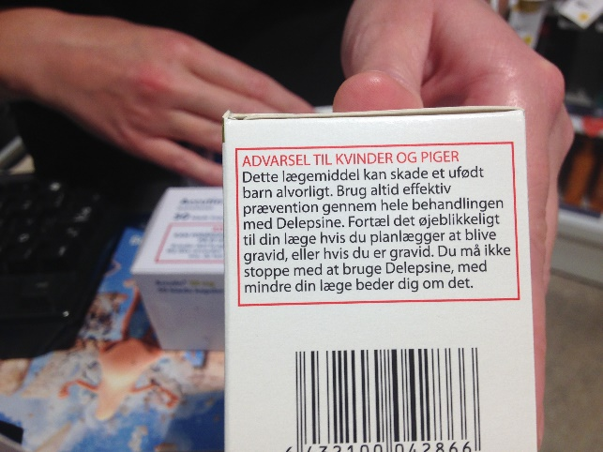
Introduction
List of medications marketed in DK
Intro to EU/EMA revised pregnancy prevention programme
Examples of the Danish measures from the pregnancy prevention programme
Intro to the project

Slide 4
Valproate Oral retinoids
API | Trade NAME | ATC
Sodium Valproate | Delepsine® | N03AG01
Sodium Valproate | Depakine Retard | N03AG01
Sodium Valproate | Deprakine® | N03AG01
Sodium Valproate | Orfiril® | N03AG01
Sodium Valproate | Valproat "Life Medical" | N03AG01
API | Trade NAME | ATC
Isotretinoin | Accutin® | D10BA01
Isotretinoin | Isotretinoin | D10BA01
API | Trade NAME | ATC
Acitretin | Acitretin | D05BB02
Acitretin | Neotigason® | D05BB02
API | Trade NAME | ATC
Alitretinoin | Toctino | D11AH04
Alitretinoin | Alitretinoin | D11AH04

Slide 5

Intro EMA pregnancy prevention for valproate-containing medicinal products
Valproate is licensed for the treatment of epilepsy and manic episodes in patients with bipolar disorders. Also for prophylaxis of migraine in some EU countries.
2014 review: Identified a risk of malformations and neurodevelopment disorders of children exposed in utero.
  Valproate should not be used in women with childbearing potential.
  Warnings and precautions in the product information.
  Educational material.
2018: The PRAC/EMA has updated risk minimization measures
From Sarah Brøgger Kristiansen presentation, 2020
Notes:
The Pharmacovigilance Risk Assessment Committee (PRAC) is the European Medicines Agency's (EMA) committee responsible for assessing and monitoring the safety of human medicines.

Slide 6
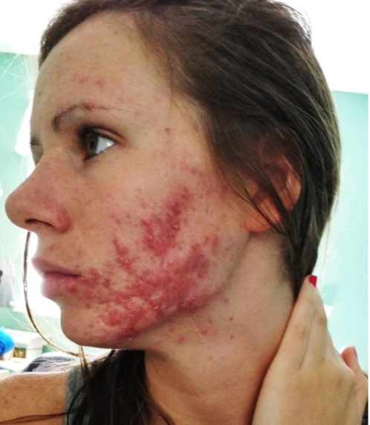
Intro to EMA pregnancy prevention programme for oral retinoid containing medicinal products
Oral retinoids are used to treat acute and chronic dermatological conditions e.g. acne, eczema, psoriasis.
Highly teratogenic (30%) and must not be used during pregnancy.
Treatment should be stopped before planned pregnancy.
2003: first PPP program.
  Poor compliance with program. Still many (pregnancy) cases.
2018: The PRAC/EMA has updated and strengthened risk minimization measures
From Sarah Brøgger Kristiansen presentation, 2020

Slide 7
Examples of the Danish PPP measures: educational material
Dansk uddannelsesmateriale (laegemiddelstyrelsen.dk)
Notes:
Now lets take a look at educational material and some warning on packages in Denmark.
All the education material can be found on the Lægemidelstyreslsen website. Let’s take a closer look.
To show the labels, another colleague just went to a pharmacy and took some pictures. And here they are.

Slide 8
Examples of the Danish warning on packages- valproate
Johanne M. Hansen pictures

Slide 9
Examples of the Danish warning on packages- oral retinoids
Johanne M. Hansen pictures

Slide 10
Project
EMA tender
Qualitative study – questionnaire on awareness and adherence to 2018 measure
  8 countries: NL, BE, DK, SP, PO, GR, SLO, LA
Quantitative study – register study for medication use and switch before after 2018
  Currently being conducted

Slide 11
Results of the Questionnaire study

Slide 12

Lessons learned for pharmacists in DK
Worse awareness about teratogenicity of valproate compared to prescribers and patients in DK, and pharmacists in other countries
Based on patients reports, lacking counselling on teratogenicity and importance of pregnancy prevention while dispensing valproate
A bit better, but still not as high as in other countries counselling on teratogenicity and importance of pregnancy prevention while dispensing oral retinoids.
Poor awareness and use of pharmacist check list while dispending oral retinoids, but intentions to use it more in the future

Slide 13

Further research
Analysing existing data
Closer look at oral retinoids data for DK
Systematic analysis og open ended questions for DK
Future data collection
Study among pharmacy technicians in DK
Qualitative studies to deeper understand the results for prescribers, patients and pharmacists in DK

Slide 14


