Slide 1
The creation, the running, the organization, the ups and downs –and some of the projects…
Lotte Stig Nørgaard
(Co)-initiator and steering group member of DNCPPRD
(in Danish NUAP)

Slide 2
Agenda
Who is here tonight? (20.00-20.10)
Presentation (Lotte) (20.10 – 20.50)
Break and Breakouts (20.50– 21.30)
Catching up, planning and goodnight (21.30 – 22.00)

Slide 3
Aim
Informed you about the Danish Pharmacy Network
Given you ideas for how to create and run
your own pharmacy network (projects)
Connected you with new and “old” pharmacy friends…
Additional aims??

Slide 4
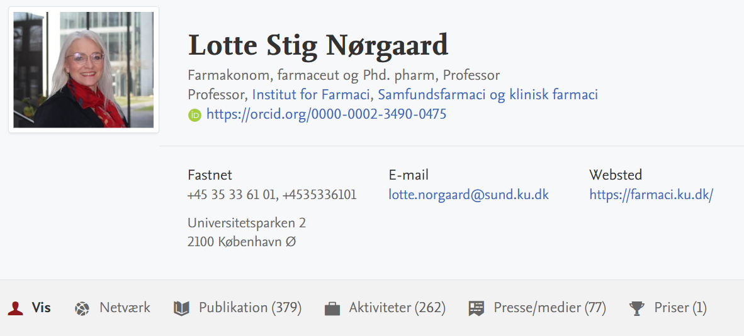

Slide 5
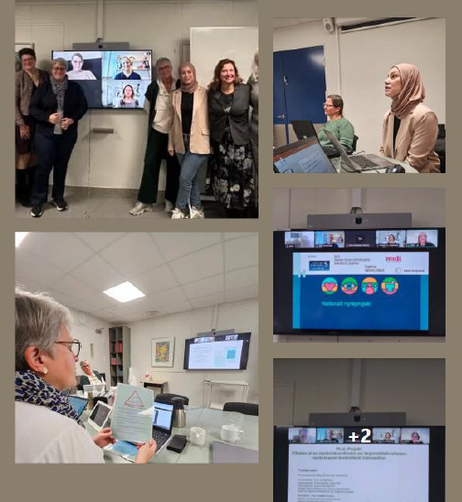
Presentation
Why?
How (organization)
Why did/do we succeed?
Selected research projects
Finding us/our papers

Slide 6
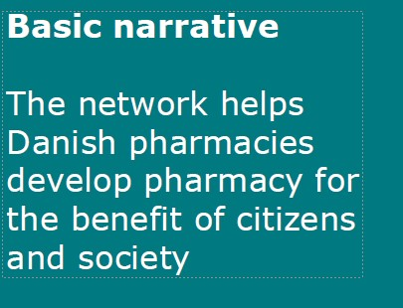
Network established in 2016
App. 100 pharmacies are members
Aim: to strengthen pharmacy practice and pharmacy practice research in Denmark by providing a forum where researchers and representatives from community pharmacies meet to share knowledge and support evidence-based community pharmacy practice.

Slide 7
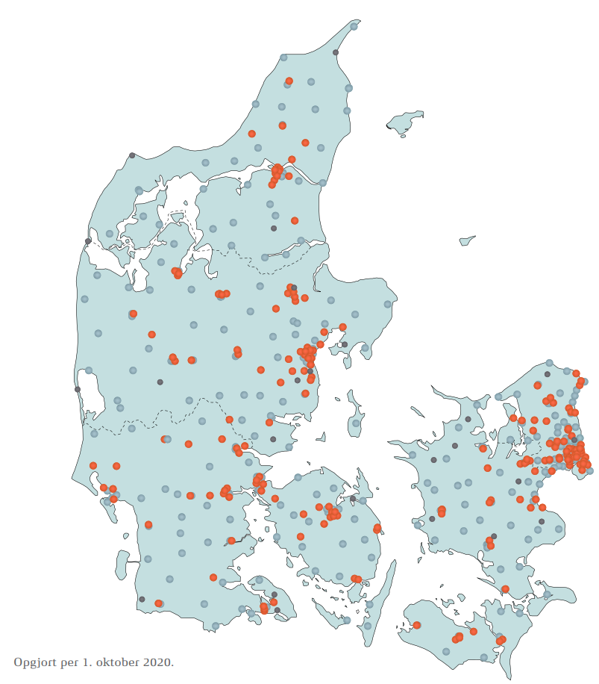
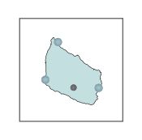
Community pharmacies in Denmark
More than 520 community pharmacies
197 pharmacy owners
12 staff per pharmacy
96,500 customer visits
222 daily prescription customers
Turnover: DKK 25 million (EUR 3.3 million)
Notes:
As of January 2021, there were 512 community pharmacies in Denmark, including pharmacy branches. There are 196 main pharmacies. Every dot on the picture is a pharmacy (red dots are new branches since 2015, light blue are before 2015 and dark blue are pharmacy outlets). Community pharmacies are privately owned, and only pharmacists can own a pharmacy, following a license given by the Danish Medicines Agency. There are currently 194 pharmacy owners.
The number of staff in an average Danish community pharmacy is 12 employees per pharmacy. Most of those are pharmacy technicians. Danish community pharmacies employ 777 pharmacists holding a five-year MSc degree in pharmacy, 2,737 pharmacy technicians with a three-year academy profession degree and 446 pharmacy technician students. Approximately 210 pharmacist interns complete their pharmacy internship every year at a Danish community pharmacy.
Every year there are 96,500 customer visits at an average pharmacy, with 222 daily prescription customers. The total turnover of an average pharmacy in Denmark is 25 million DKK (3,3 million EUR) every year.
If you would like to know more about the community pharmacies in Denmark, we have just published a paper about community pharmacies in primary health care in Denmark.

Slide 8
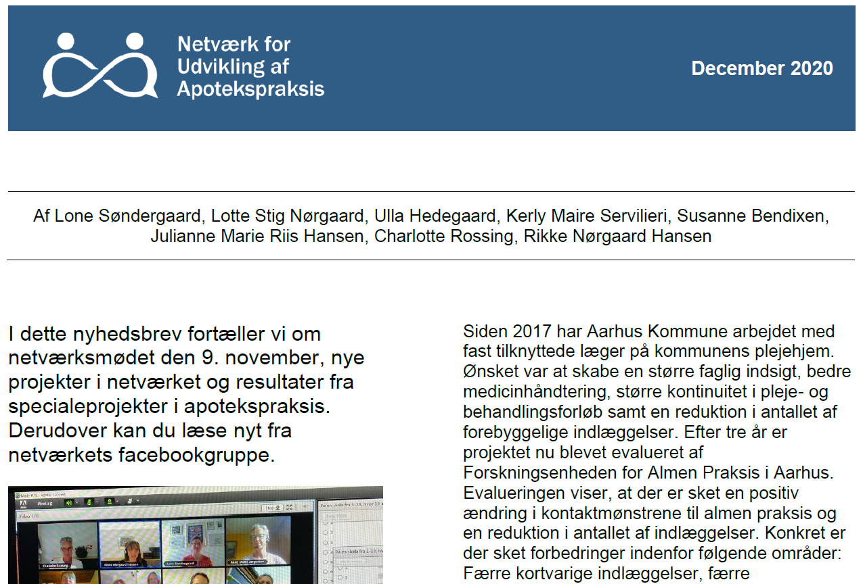

Organization I
Community pharmacy owners are members
  Pharmacists and pharmacy technicians
Four newsletters a year
No financial support
Membership is free
Steering group

Slide 9

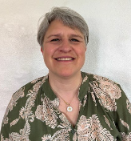
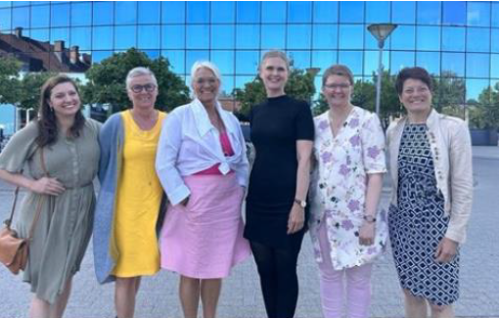
Organization II
Steering committee tasks:
An on-line meeting every month –
2 yearly physical meetings
Review board
Support project managers
Arrange network meetings (earlier…)
Collect information for newsletters
Notes:
The steering committee meets every month, mostly online and twice a year face to face. Four of the 12 meetings are about the administration and strategy of the network, for example arranging network meetings and discussing where to go next with the network. The remaining meetings are for the community pharmacies or other researchers to discuss ideas and projects – this is a new thing, because they want to give the members better access to discussion with the steering committee and researchers.
The steering committee works as a review board for the projects and they approve the projects (importance and relevance for pharmacy practice, innovative character, overlap with other projects, feasibility time and workload for pharmacies and quality of the project methodology). They support and supervise the project managers throughout the project period. I will describe it for you on the next slide.
The steering committee also arranges network meetings where all practitioners are invited. And they collect information for the newsletters.

Slide 10




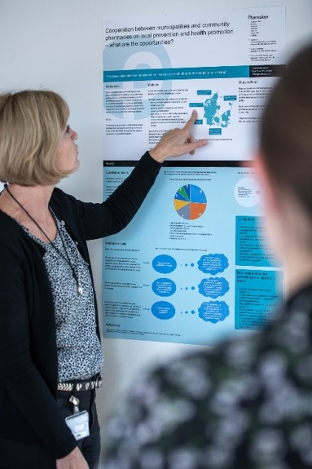



Community pharmacies and researchers meet
Discussion and collaboration
Danish Network for Community Pharmacy Practice Research and Development
Results
Ideas
Quality
Publication
Notes:
Just some more words about what we want to work for with this network. The Danish network provides a platform for community pharmacies and researches to meet. We discuss ideas which can develop pharmacy practice and with collaboration between practice and research, we ensure the quality of projects.
The network facilitates discussion and collaboration between researchers and community pharmacies. That creates results which can make the value of community pharmacies visible for patients and society when these results are published.
So this is what the network want to do and work for.
(Researchers can qualify projects and ideas from the community pharmacies, which validates the projects and gets them ready for publication. Community pharmacies can qualify projects and ideas from researchers so the projects become relevant for patients and community pharmacies.)

Slide 11
Opportunities for the community pharmacy
Expectation:
* Share knowledge and ideas
* Initiate and participate in projects
* Communicate projects and results
* Support from pharmacy management
Get, add and qualify ideas
Find collaborators
Discuss the different phases of project
Learn from other pharmacies’ experiences
Gain experience
Run own projects
Participate in other pharmacies’ projects
Communicate results
Contribute to development of pharmacy practice
Ownership
Notes:
Now I how told you about the purpose of the network, the role of the steerring commitee and examples of projects. And on this slide I have gathered some thoughts about opportunities for community pharmacies when they join the netwærk. From my point of view they can
Get, add and qualify ideas
Find collaborators all over Denmark
Discuss the project in different phases and get competent feedback
Learn from each others’ experiences
Gain experience in project management
Run their own projects
And they can Participate in projects that others are running
Communicate results and get assistance to do it
Contribute to the development of pharmacy practice
Feel a sense of ownership of research and development of pharmacy practice in Denmark; the feeling that it is not only research institutions that research and develop pharmacy practice, but the pharmacies are part of it.

Slide 12

Spreading
Project process
5
Project results are adjusted and spread to the network and other stakeholders at the end of the project
4
During the project period the steering committee provides competent feedback via contact person
3
The project is approved by the steering committee
2
The idea and project description are discussed in the steering committee together with the project manager
1
Community pharmacy staff, student or researcher sends a project idea to the steering committee
Notes:
With this figure I want to show you the process from a project idea to a completed project which can be communicated. In step one, a community pharmacy or researcher sends a project idea to the steering committee. In step two, the idea and project description are discussed in the steering committee together with the project manager at e.g. an online meeting.
In step three, the project is approved by the steering committee. Sometimes it may require a few rounds between steps two and three to ensure that the projects are on the right path and are relevant for the patients and community pharmacies and that the methods are satisfactory.
Step four is where the project is carried out. During the project period the steering committee provides feedback, and often researchers offer support to community pharmacy staff on project design and methods. In later project stages, support is provided on how to publish the results of the projects.
In step five, the project has been completed, and results are communicated to the network and other stakeholders. The network also provides communication support from the network.
So this is the path from project idea to a completed project which can be communicated.

Slide 13
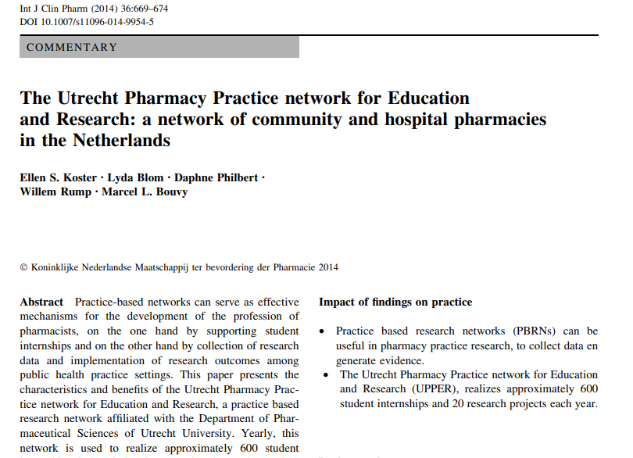
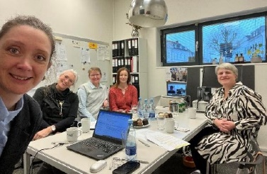

Why did/do we succeed?
History:
  Small country ☺
  Tradition for developing pharmacy practice
  Pharmacist union – local pharmacy circle association
  work – network days – Pharmacy Association consultancy
  UPPER network
Steering group: Composition, structure, secretarial support, hard work… and a lot of laughing ☺
Communication: All three unions/universities/Pharmakon, strategy, dissimination/outreach/SoMe
Projects:
  Makes work more interesting and varied
  Room for all types of projects

Slide 14
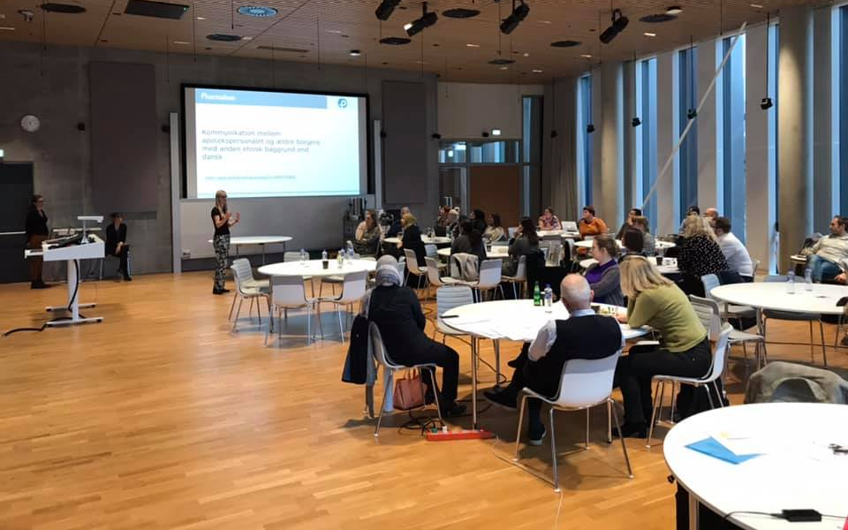
Covering practice at the community pharmacy
Development of new pharmacy health services
Improvement of existing tasks and services
Research projects
(some large and international)
Practice-based projects
(some small and just taking place in a sigle pharmacy)
Notes:
Now something about the projects in the network. The projects fall into two categories: Research projects started from the research institutions, this could also be pharmacist master’s projects, and practice-based projects started and often completed by the community pharmacies.
Right now the projects typically fall into three themes:
Covering practice at the community pharmacy – what is happening at the pharmacy today
Development of new pharmacy health services
Improvement of existing tasks and services

Slide 15
Completed projects I (some of the 45)
Communication between community pharmacies and elderly people with ethnicities other than Danish
Customers’ information seeking behavior prior to community pharmacy visits
Assessment of dosage rationality of antibiotics to infants, children and adolescents
Unavailable prescriptions at Danish community pharmacies: a national descriptive study
Reduction in long-term treatment with proton pump inhibitors (several studies)
Collaboration between community pharmacies and general practices
COVID-19 affecting community pharmacies - from pharmacy students’ point of view
Tripple whammy effect – safe use of NSAID
Optimised medication counselling – a pharmacy practice research project
Narrative medicine in pharmacy practice – a feasibility study
Quality of pregnancy prevention in women using teratogenic drugs
KliAkkit – a technology which supports adherence counselling
Establishing an inter-professional collaboration between hospital and community pharmacists in Denmark
Pharmacy customers’ wishes and attitudes towards COVID-19 antibody test
Shortage of medicine in community pharmacies
Notes:
With this overview of completed projects in the network I want to show you that 10 projects have been completed. When the network was established, more projects were initiated by the research institutions and fewer by the community pharmacies. The ones with the red arrows were initiated by the community pharmacies.

Slide 16
Completed projects II (some of the 45)
Stop Medicine Waste Alliance study
Towards more appropriate use of drugs – Testing models for stopping unnecessary treatment with PPIs
Job satisfaction among pharmaconomists and community pharmacists in DK
15 STARS – validation questionnaire – patient compliance
PEP device training for patients at community pharmacies
Wegovy use in DK
Feedback guide – pharmacy counter
Pharmacy and late effects of cancer (several sub-studies)
Experiences with abuse of OTC medication in community pharmacies
Notes:
With this overview of completed projects in the network I want to show you that 10 projects have been completed. When the network was established, more projects were initiated by the research institutions and fewer by the community pharmacies. The ones with the red arrows were initiated by the community pharmacies.

Slide 17
Projects running (11)
My everyday life at a pharmacy (photovoice study)
Scope and practice of re-prescribing service in community pharmacy (questionnaire)
Understanding medicines and GP dialogue among elderly patients (master thesis study)
Interdisciplinary cooperation between pharmaconomists and pharmacists (master thesis study – qualitative)
Opiod-user knowledge and experience with risk of falling (questionnaire)
Retaining pharmacists at the pharmacy (community pharmacist initiated)
Pharmacist perspectives on potential pharmacist prescribing (PCNE-initiated study)
Effect and dosing of semaglutid (Ozempic)
Attitudes towards health related research (phd.-study)
Creating a common understanding about pharmacy core task (one pharmacy)
Patient voices in research – the elderly
Notes:
This is an overview of ongoing projects in the network (12 projects). As you can see, more of them are what we call practice-based projects that started at the community pharmacy and are managed by one or more community pharmacies.
I would like to tell you more about the first one: Triple whammy effect – safe use of NSAID.

Slide 18
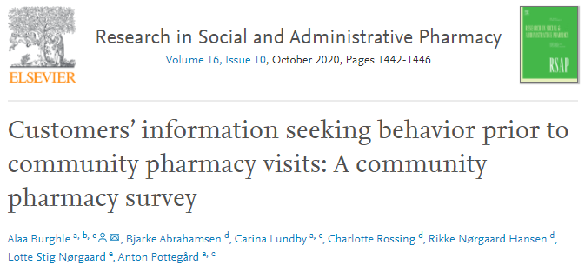
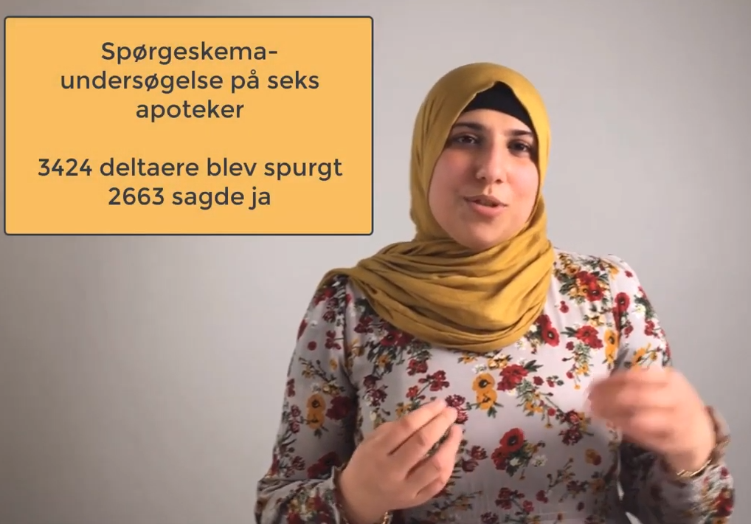
Six community pharmacies
Data collection for three weeks
2,623 customers
14.4% sought information
Notes:
The idea for this project was conceived at a meeting with some of the first community pharmacy members of the network. The project was later developed by the steering committee and further at another network meeting with community pharmacy members.
The project aimed to quantify and describe customers’ information seeking behaviour prior to community pharmacy visits, (and to describe how pharmacy staff use this information in their counselling.)
All members of the network were invited to participate in the project, and a total of six community pharmacies agreed to participate in the data collection. The participating community pharmacies were instructed to collect data through a survey for three weeks in November 2018. Online meetings to support the data collecting community pharmacy staff by experience sharing and answering questions were conducted weekly during the data-collection period. A total of 2,623 customers agreed to participate in the survey, of whom 14.4% sought information prior to visiting the community pharmacy. The project resulted in a paper² published in Research in Social and Administrative Pharmacy.
The results were discussed at a network meeting in November 2019, where community pharmacies discussed how they could use this new knowledge in their counselling of patients, for example by routinely asking patients whether they had sought information prior to visiting the pharmacy and having a dialogue on the basis of the patients’ knowledge from their search for information.
So this was an example of one of the completed projects which started as an idea from a community pharmacy at a meeting, and was carried out through collaboration between researchers and community pharmacies.
(The data collected in this project included: whether the customer sought information before visiting the pharmacy, sources of information, the customers’ motivation for seeking information, what the information concerned; medication, supplements, symptoms, treatment etc. Finally, the pharmacy staff recorded what they did with the information which the customer presented at the counter.)

Slide 19
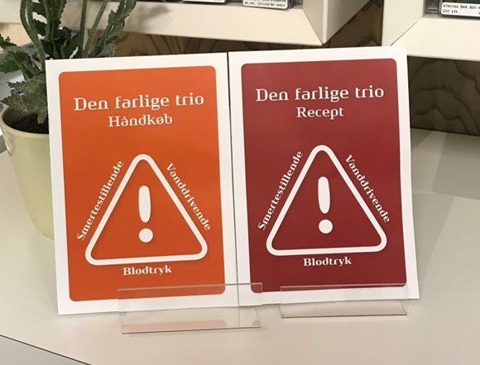
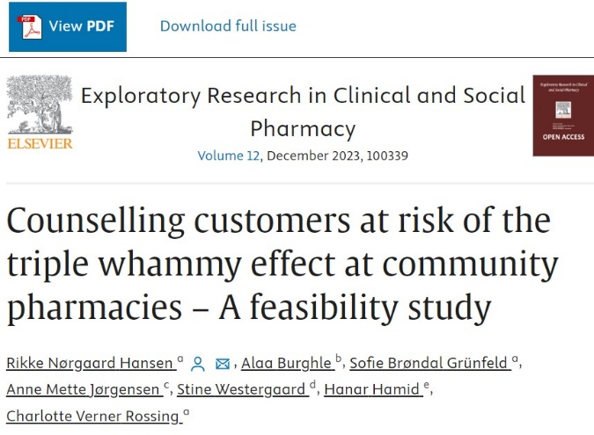
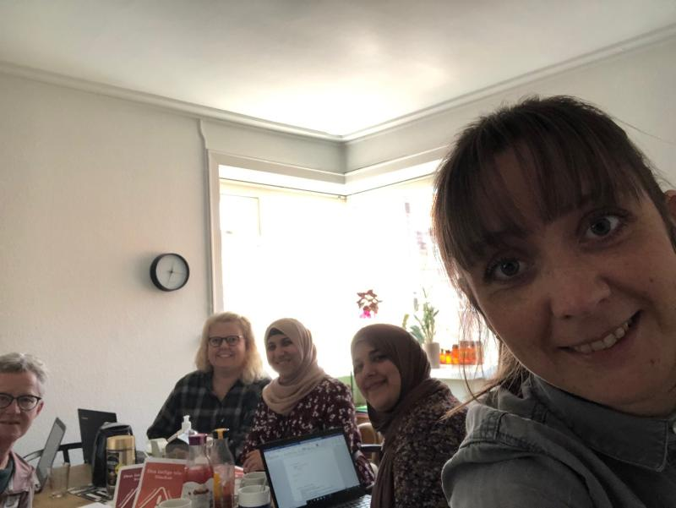
Triple whammy effect – safe use of NSAID
Idea and discussion at network meetings
12 community pharmacies
8% of costumers at risk of TWE
Notes:
The aim of the project is to:
Cover the number of patients in community pharmacies who get the triple whammy combination
Give the patients information through an information leaflet and to counsel the patients about the effect
Spread the knowledge about the triple whammy combination at the community pharmacies, so they can help the patients and physicians.
The idea for this project started at a network meeting in 2019. At the next network meeting, the initiators were able to discuss their thoughts about the purpose and the content with other community pharmacies and researchers. Particularly, they received competent feedback on the methodology from researchers. One of the participants in the project group had to leave the project, but the project didn’t stop – because of the great network of other community pharmacies, three new members of the project group (two community pharmacists and one researcher) were able to step in within a few days.
The community pharmacists make all the materials for patients and community pharmacies, and a researcher is in charge of the data collection. 12 pharmacies are right now ready to collect data and carry out the intervention from April this year.
This was one more example of a practice based project and which bump on the way can be met where the network step up and support.

Slide 20

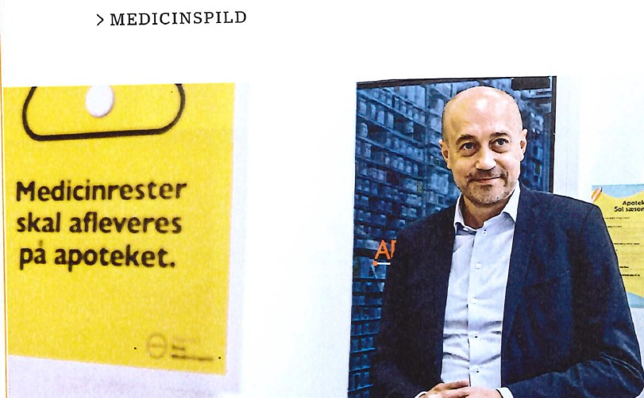

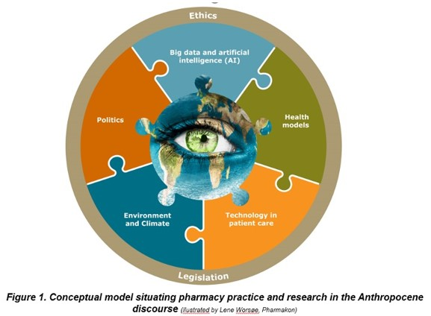
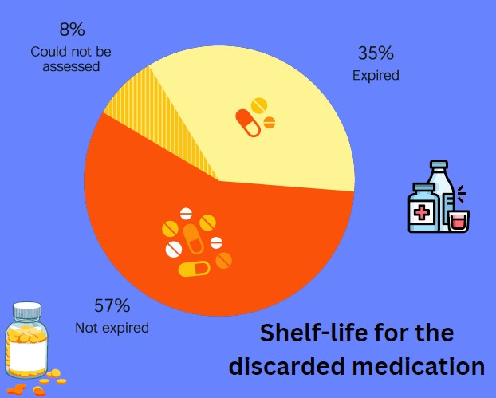

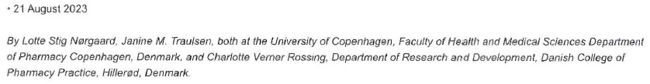
Selected RESULTS
Stop Medicine Waste:
Graabaek T, Amstrup G, Blenstrup BG, Kloster KV, Winther BN, Thøgersen P. Nørgaard LS. MEDICATION WASTE DELIVERED BY CITIZENS TO DANISH COMMUNITY PHARMACIES. 2023. Poster, The European Society of Clinical Pharmacy (ESCP) Symposium , Aberdeen, Storbritannien.
Graabæk Hansen T, Nørgaard LS. Indleverede medicinrester på apotekerne er ofte uåbnede. Pharma. 2023 jun. 19;2023(5):26-28.
Hansen TG, Nørgaard LS, Amstrup G, Winther BN, Thøgersen P, Kloster KV. Undersøgelse af medicinrester afleveret af borgere på apoteker i Danmark. I Undersøgelse af medicinrester afleveret af borgere på apoteker i Danmark. 2023. s. 1-19
Graabæk T, Amstrup G, Blenstrup BG, Kloster KV, Winther BN, Thøgersen P, Nørgaard LS. Stop Medication Waste – a Descriptive Study of Discarded Medications Delivered by Citizens to Danish Community Pharmacies. Oral presentation at Nordic Social Pharmacy Conference 7-9 juni 2023
39 pharmacies
One week: 4,384 registrations of discarded medications were completed (average 112 packages/pharmacy) (3 mio packages/year)
21% of drug packages were unopened packages and 40% contained half or more in the package.
12 % of discarded medicine comes from estates
The price for discarded medications total appr.
410 mio DKK/yearly
(number attached some with uncertainties)

Slide 21
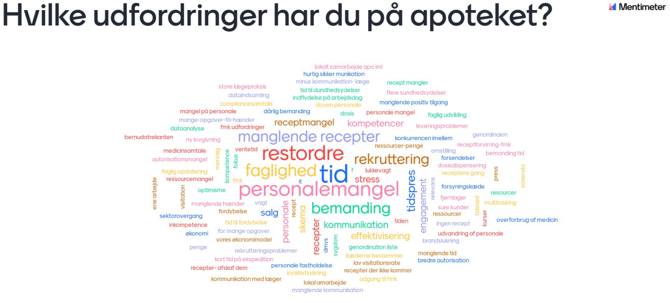
What challenges do you face at your pharmacy?
Source: Danish community pharmacy conference 2022
appr. 180 community pharmacists participating

Slide 22

Quotes from participating community pharmacists and researchers
“It is very motivating in my daily job at the pharmacy to participate in projects. It gives me an opportunity to be updated about what is going on in the community pharmacy sector.”
Community pharmacist
“Collaboration with other community pharmacies and researchers push me out of my comfort zone and increase my competences in project management.”
Community pharmacist
“The network makes my research realistic and close to the pharmacies and the patients.”
Researcher
“Projects in the network make all staff feel well equipped for a dialogue with the patients.”
Community pharmacist
“The data collection becomes more effective when many community pharmacies, which I have access to through the network, participate. It generates a lot of data in a short period of time.”
Researcher
“My research is now visible for more community pharmacies. That gives me plenty of new ideas which can develop pharmacy practice further”
Researcher
Notes:
Last week I asked some community pharmacists and researchers about the opportunities and benefits they get from the network, so that I could share some fresh thoughts about joining the network with you.
These participants find that the network contributes to the practice and development of the community pharmacy, to research and new ideas on developing pharmacy practice, and that the collaboration strengthens the dialogue and will help the patients.

Slide 23



What lies ahead of us?
More practitioner- and especially pharmaconomist-initiated projects
Cooperation with
Securing that project leaders want steering group input
Support project leaders in seeking funding
Projects on staff maintenance, use of AI
Even more communication and interaction – nationally and internationally… FIP congress in Danmark 2025 ☺

Slide 24
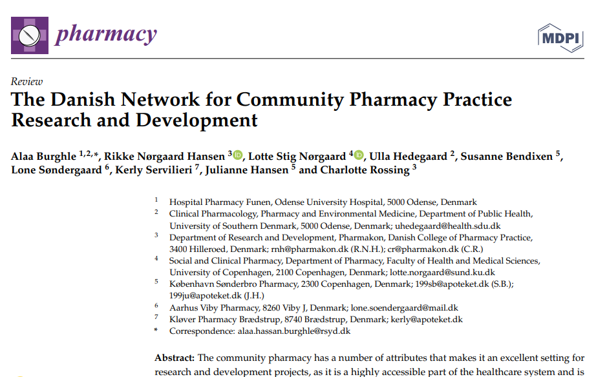
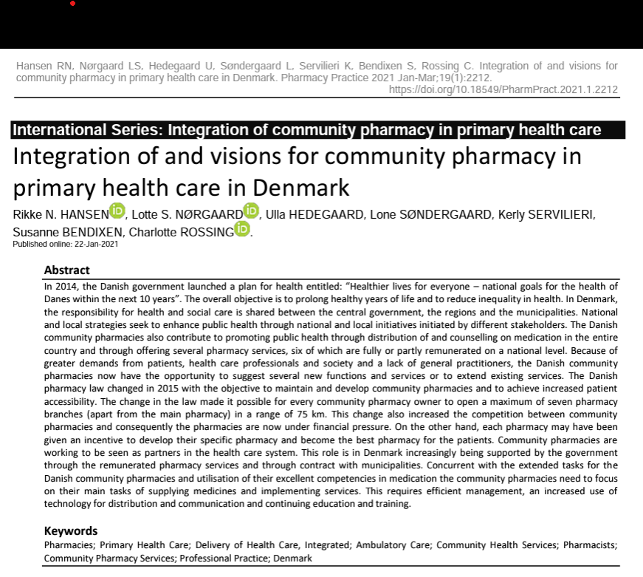
Institutional member of Pharmaceutical Care Network Europe (PCNE) in 2023

Slide 25

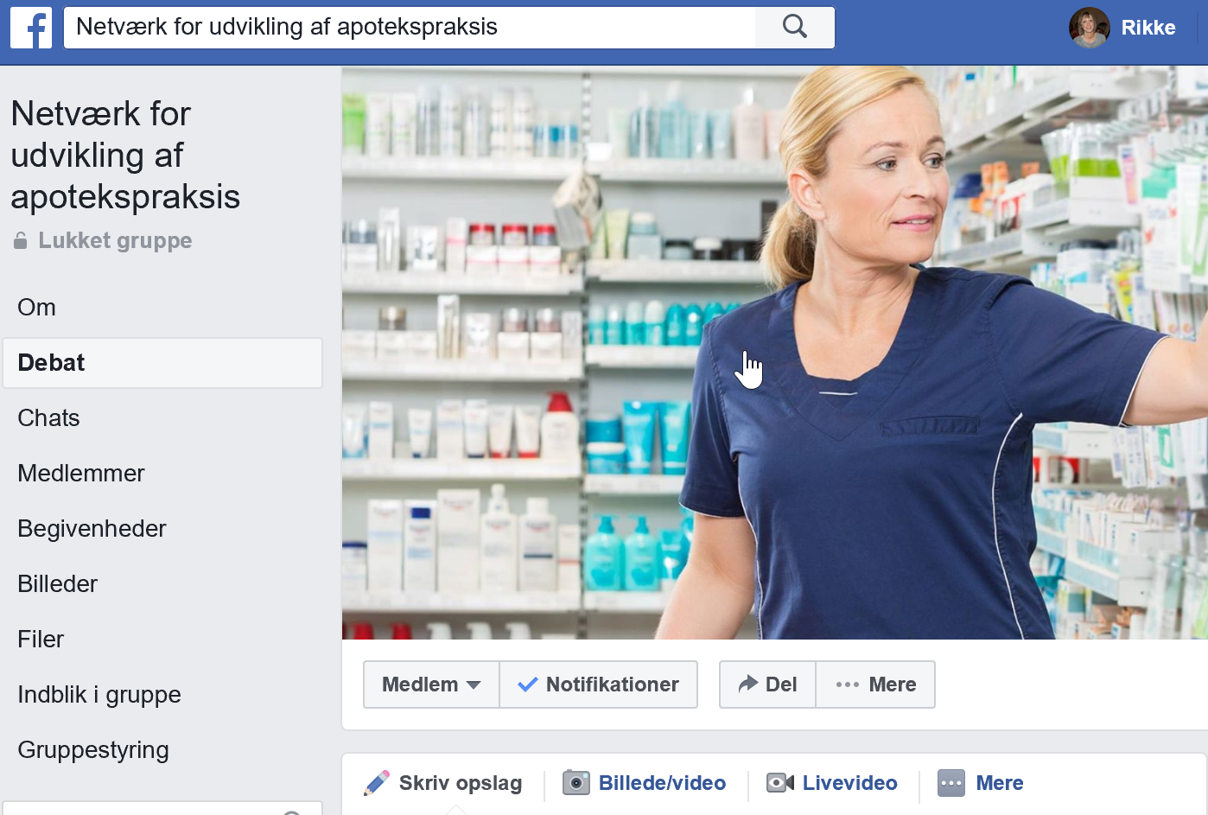
https://www.pharmakon.dk/forskning/apoteksnetvaerk/

Slide 26


If you want to initiate a network like this
Do it
Be patient and prepared for changes
A lot of energy
A network is not built in one day
Start with few participants
Communication platforms
Who can see the value
From steering committee and interactive
Ambassadors among
community pharmacies
Coordinating role
Place the responsibility
Communication and recruitment
Notes:
On this last slide I have gathered some points I think you should consider if you want to initiate a network for community pharmacy practice research and development in your country:
Do it: it gives great energy for both community pharmacies and research when we share and discuss ideas and projects. In that way we contribute to developing pharmacy practice with the purpose of helping patients with medicine.
Start with a few community pharmacies and researchers who are keen, see the value and are ready to invest time.
When you need to spread the word and get more participants, make sure you have ambassadors who can communicate the value and who community pharmacies listen to.
Make sure you place responsibility for the coordinating role of the network and the steering committee – you need someone to keep track of members, meetings, communication platforms etc.
Good communication is a basic condition for the success of a well-functioning network – find out which communication platforms would work in you country – that goes for communication from the steering committee as well as interactive platforms where members can communicate with each other, e.g. Facebook.
Be patient and be prepared to make changes to make the network work. Some things you try will not work. Then try something else and ask the members what they wish for. You cannot build this platform in one day or one year, but with passionate researchers and community pharmacies you can create a network over time.

Slide 27

Breakout discussion points (21.00-21.30)
Introduce yourself
First impression of presentation/Danish network?
  Questions to ask Lotte?
The dream: Your own ideas for how to develop pharmacy practice in Belgium?
  What projects to initiate?
  With whom to cooperate?
  Creation of network (steering commite? Economy)
  What are the major obstacles for your dream to come true?

Slide 28
Catching, discussing and planning (21.30-22.00)
First impression of presentation/Danish network?
Questions to ask Lotte?
The dream: Your own ideas for how to develop pharmacy practice in Belgium?
What projects to initiate?
With whom to cooperate?

Slide 29
Catching, discussing and planning (21.30-22.00)
Creation of network (steering commite? Economy)
What are the major obstacles for your dream to come true?
Next step (planning)?

